Slide 1
Image steganography End term minor project presentation
By:
Dhruv Chaudhary (209303197)
LSS Jyotiraditya (209303292)

Slide 2
Agenda
Introduction
Existing Technologies
Aim
Motivation
Working/Methodology
LSB Implementation
DCT & DWT
Qualitative Analysis Parameters
Results
Conclusion
Bibliography

Slide 3
introduction
Image steganography is a technique that has gained significant attention in recent years as a means of securing communication channels. It involves the hiding of secret messages or data within an image without causing any noticeable changes to the image's quality.
The use of steganography has become increasingly popular due to the increasing need for secure communication channels in various fields such as military, finance, and healthcare.
This technique has led to the development of various algorithms and methods for hiding information within an image. As a result, it has become a crucial tool in maintaining privacy and security in this digital age.
In this project we will to two domains of image steganography techniques used: Spatial Domain techniques (LSB method) and Transform Domain Techniques (DWT/DCT methods)

Slide 4
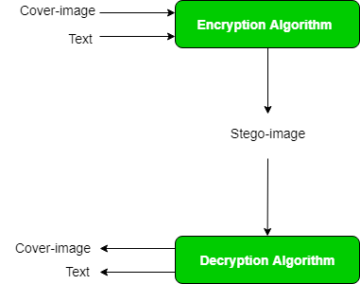
Visual representation of image steganography

Slide 5
Existing technologies
EXISTING METHODS | PROS | CONS
Least Significant Bit | Easy to implement, high hiding capacity | Vulnerable to attacks, noticeable reduction in image quality
Phase Coding | Difficult to detect, high hiding capacity | Computationally intensive, vulnerable to attacks
Spread Spectrum | Robust, high hiding capacity | Computationally intensive, noticeable reduction in image quality
Distortion-Based | Difficult to detect, high hiding capacity, small changes made | Noticeable reduction in image quality, vulnerable to attacks

Slide 6
aim
In this project, we aim to explore the implementation of image steganography through Python and evaluate their performance. Our goal is to evaluate the strengths and limitations of different steganographic techniques and decide on and propose a novel method that offers better performance.
The significance of this study lies in its potential to enhance the security of communication channels by enabling the transmission of sensitive information without raising any suspicion. The results of this study can be used to inform the development of more efficient and robust steganographic methods that can be applied in various fields.

Slide 7
methodology
Research and Review Existing Techniques: Conduct a thorough review of existing image steganography techniques, including their strengths and weaknesses, to identify gaps and opportunities for improvement.
Define Requirements: Define the specific requirements of the project, such as the parameters as well as the software and hardware requirements needed to implement the project.
Implement the System: Implement the different image steganography system by writing code, configuring software, and testing the system to ensure that it meets the requirements.
Test and Evaluate the System: Conduct comprehensive testing to evaluate the performance, security, and efficiency of the implemented system. Test the system under various conditions to identify any weaknesses or vulnerabilities.
Improve the System: Based on the results of testing, identify areas for improvement and implement enhancements to the system.

Slide 8
Working of least significant bit method (lsb) for image steganography
This technique changes the last few bits in a byte to encode a message, which is especially useful in something like an image, where the red, green, and blue values of each pixel are represented by eight bits (one byte) ranging from 0 to 255 in decimal or 00000000 to 11111111 in binary.
Changing the last two bits in a completely red pixel from 11111111 to 11111101 only changes the red value from 255 to 253, which to the naked eye creates a nearly imperceptible change in color but still allows us to encode data inside of the picture.
The least significant bit technique works well for media files, where slightly changing byte values creates only slight imperceptible changes, but not so well for things like ASCII text, where a single bit out of place will completely change the character. That's not to mention the fact that data hidden using LSB steganography is also easy to detect if someone is looking for it.

Slide 9
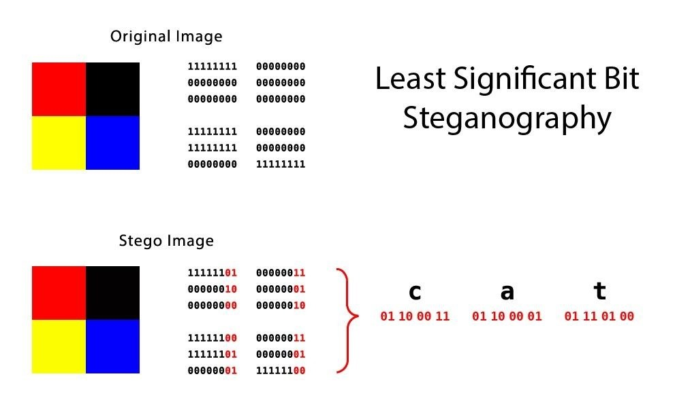
Visual representation of lsb method

Slide 10
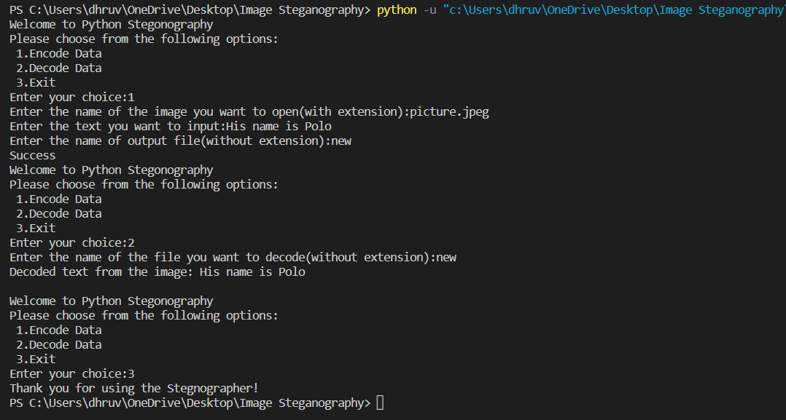
Code implementation of lsb method

Slide 11
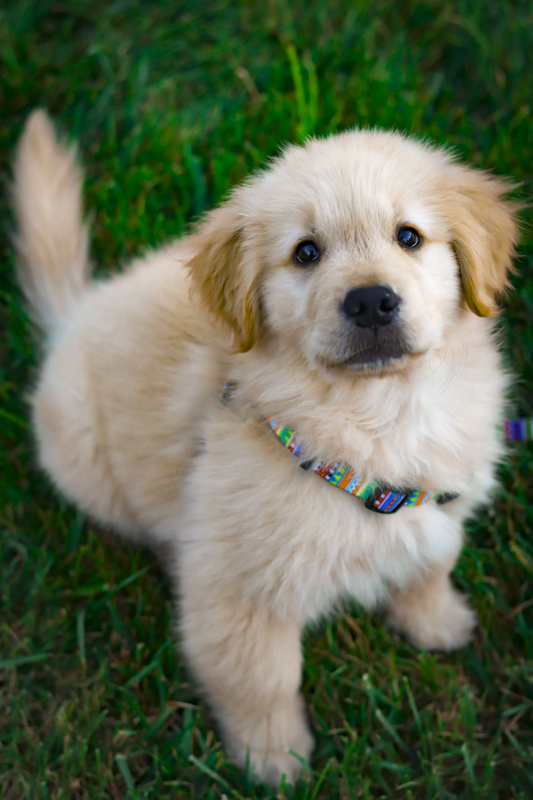
continued
As you can see, there is virtually no visible difference
From naked in the two pictures. But, there is in fact, an
Encoded message in the second picture (new.png)
Picture.jpeg
New.png

Slide 12
Progress since mid term
Research regarding other existing techniques
Evaluate their performances using case studies to determine effectiveness in particular fields or situations to determine a qualitative analysis for methods
As a result, determine use cases for three techniques we discuss moving forward

Slide 13
DCT
The Fourier transform was originally used on heat conduction but later gain usage in various applications and became a base for other transformation like DCT. Images and videos compression algorithm uses DCT to transform into frequency domain and data compression is done through quantization. Image is divided into parts or sub-bands.
The Discrete Cosine Transform (DCT) is a mathematical technique used to analyze signals such as images, videos, and audio. In image processing, the DCT is applied to a block of pixels in an image to transform it into the frequency domain. The resulting coefficients represent the frequency components of the image in a way that enables compression and other signal processing operations. The DCT is widely used in image and video compression algorithms such as JPEG and MPEG.

Slide 14
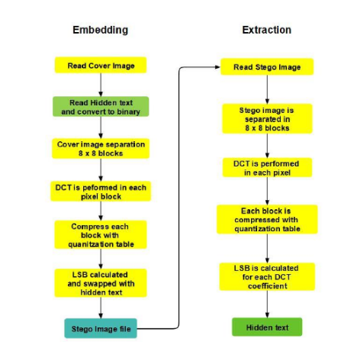
DCT IMAGE STEGANOGRAPHY FLOW

Slide 15
Algorithm of Image Steganography for text message embedding in DCT:
First Cover Image is read
Hidden message is read
Binary conversion of hidden message.
Cover Image is separated into 8 x 8 pixel blocks.
For each Pixel block DCT is performed.
Quantization table is used to compress each block.
LSB is calculated of each DCT coefficients and swapped with the hidden message.
Stego image is produced.

Slide 16
Algorithm of Image steganography for text message extraction in DCT:
First Stego image is read
Then next, through 8 x 8 block of pixels stego image is separated.
Then in each Pixel block DCT is performed.
Now after this step, quantization table is used to compress each block.
For each DC coefficient LSB is computed.
Convert each bits into character and retrieve the hidden message.

Slide 17
DWT
DWT is a way to transform from spatial to frequency domain. DWT is used in JPEG 2000 compression which is very popular. Wavelets are basically functions that integrate to zero waving below and above the x axis.
For Signal and image processing, wavelets are used as the basic function like sines and cosines in Fourier transform

Slide 18
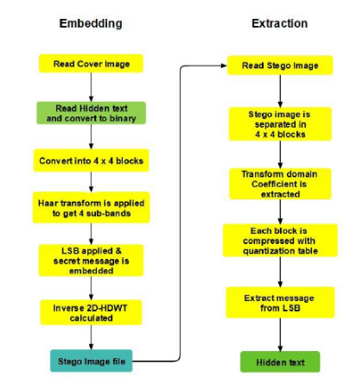
DWT IMAGE STEGANOGRAPHY FLOW

Slide 19
Algorithm of Image steganography for text message embedding in DWT:
1. Cover Image is read.
2. The hidden message is read
3. Binary conversion of hidden message.
4. Convert the cover image into 4 x 4 blocks.
5. 2D-Haar transform is applied to get 4 sub-bands LL, HL, LH & HH.
6. LSB of each sub-band is changed and secret hidden message is embedded into it.
7. Inverse 2D-HDWT (Haar Discrete Wavelet Transform) is calculated for each 4 x 4 block.
8. Stego image is produced.

Slide 20
Algorithm of Image steganography for text message extraction in DWT:
The Stego image is read.
Stego image is divided into 4 x 4 blocks
Transform domain coefficient is extracted by using 2D Haar Discrete Wavelet Transform (HDWT) for each block.
Extract message from LSB in each pixel
Hidden message is extracted

Slide 21
Qualitative analysis parameters
Parameters such as imperceptibility, capacity, and robustness are evaluated.
(a) Imperceptibility: It refers the stego file quality post embedding the secret text. This is a significant factor in steganography wherein if the stego file doesn’t retain its quality, it can be suspected to have hidden information.
(b) Capacity: It refers to the size of the secret message that can be embedded in the carrier or cover file.
(c) Robustness: It refers to withstand manipulation of the stego file such that the embedded secret information can be retrieved after various attacks like scaling, cropping, compression, rotation, blurring, noise adding, filtering and re-mastering.

Slide 22
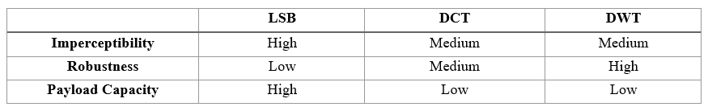
RESULT: QUALITATIVE Analysis/comparison table

Slide 23
RESULTS: USE CASE (LSB)
Possible Use Case: Digital Watermarking for Copyright Protection
Justification: LSB has good imperceptibility, which means that it can embed data in an image without causing noticeable changes to the image. In the case of digital watermarking, the watermark is usually a small piece of data, such as a logo or a copyright notice. LSB is capable of embedding this data in a way that is not noticeable to the human eye. Additionally, LSB has high payload capacity, which means that it can embed a large amount of data in an image. This is useful in cases where multiple watermarks need to be embedded in the same image or where the watermark needs to be resistant to attacks that attempt to remove or alter the watermark.

Slide 24
USE CASE (DCT)
Use Case: Medical Imaging for Patient Information Embedding
Justification: DCT has moderate imperceptibility, which means that it can embed data in an image without causing noticeable changes to the image in some parts of the image, but in some cases, it can be noticeable in certain parts of the image. In the case of medical imaging, patient information needs to be embedded in a way that is not noticeable and does not interfere with the diagnosis or interpretation of the image. DCT is capable of embedding this data in the frequency domain, which is less perceptible to the human eye. Additionally, DCT has good robustness, which means that the embedded data can survive image compression or other manipulations that might occur during the transmission or storage of the image.

Slide 25
USE CASE (DWT)
Use Case: Military and Intelligence Applications for Secure Data Transmission
Justification: DWT has good imperceptibility and high robustness, which makes it suitable for applications where high security is required. In the case of military and intelligence applications, the data that needs to be transmitted or stored is sensitive and needs to be protected from unauthorized access. DWT is capable of embedding data in an image in a way that is not detectable and is resistant to attacks that might attempt to remove or alter the embedded data. Additionally, DWT has high payload capacity, which means that it can embed a large amount of data in an image, making it suitable for applications where a large amount of data needs to be transmitted or stored securely.

Slide 26
Future Scope
Implement a GUI Application for a steganography GIF feature to be implemented in a texting social application
Implement a new unique method of image steganography by tweaking existing methods such as LSB or by creating a working combination of two existing techniques combing the pros of both

Slide 27
USE CASE (TEXTING APP)
For a simple implementation of adding an image steganography feature in a text messaging app, the LSB technique would be suitable.
The LSB technique is the simplest and most widely used image steganography technique. It involves modifying the least significant bit of each pixel in an image to embed the secret data. This technique is relatively easy to implement and has low computational complexity, making it suitable for applications with limited resources.
In the case of a text messaging app, users may want to embed a small amount of data, such as a short message or a small image, in the cover image. The LSB technique has high payload capacity and can embed a relatively large amount of data in the image, making it suitable for this type of application.
Additionally, the LSB technique has good imperceptibility, which means that the modified image is visually similar to the original image, making it difficult for an attacker to detect the presence of the embedded data.
Overall, for a simple implementation of adding an image steganography feature in a text messaging app, the LSB technique is a good choice because it is easy to implement, has high payload capacity, and good imperceptibility.

Slide 28
bibliography
https://www.geeksforgeeks.org/image-steganography-in-cryptography/
https://www.javatpoint.com/image-steganography
https://www.mygreatlearning.com/blog/image-steganography-explained/
https://www.cscjournals.org/manuscript/Journals/IJCSS/Volume6/Issue3/IJCSS-670.pdf
https://techvidvan.com/tutorials/python-image-steganography/

